Slide 1
Autoencoders.

Slide 2
Autoencoders are an unsupervised learning technique in which we leverage neural networks for the task of representation learning.
A neural network architecture which introduces a bottleneck which forces a compressed knowledge representation of the original input.

Slide 3
If the input features were each independent of one another, this compression and subsequent reconstruction would be a very difficult task. However, if some sort of structure exists in the data (i.e. correlations between input features), this structure can be learned and consequently leveraged when forcing the input through the network's bottleneck.

Slide 4
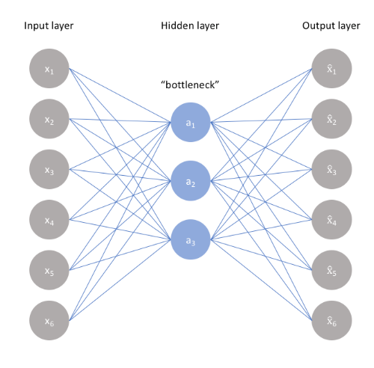

Slide 5
we can take an unlabeled dataset and frame it as a supervised learning problem tasked with outputting x^, a reconstruction of the original input x.
This network can be trained by minimizing the reconstruction error, which measures the differences between our original input and the consequent reconstruction. The bottleneck is a key attribute of our network design; without the presence of an information bottleneck, our network could easily learn to simply memorize the input values by passing these values along through the network (visualized below).

Slide 6
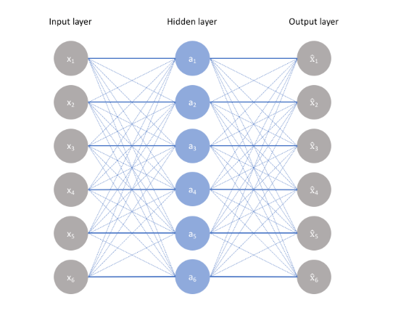

Slide 7
A bottleneck constrains the amount of information that can traverse the full network, forcing a learned compression of the input data.

Slide 8
The ideal autoencoder model balances the following:
Sensitive to the inputs enough to accurately build a reconstruction.
Insensitive enough to the inputs that the model doesn't simply memorize or overfit the training data.
This trade-off forces the model to retain the salient information and ignore the rest(ex noise) – an analogy is compression.

Slide 9

This involves constructing
A loss function where one term encourages our model to be sensitive to the inputs (ie. reconstruction loss L(x,x^)) and
a second term discourages memorization/overfitting (ie. an added regularizer).

Slide 10
The simplest architecture for constructing an autoencoder is to constrain the number of nodes present in the hidden layer(s) of the network, limiting the amount of information that can flow through the network. By penalizing the network according to the reconstruction error, our model can learn the most important attributes of the input data and how to best reconstruct the original input from an "encoded" state. Ideally, this encoding will learn and describe latent attributes of the input data.

Slide 11
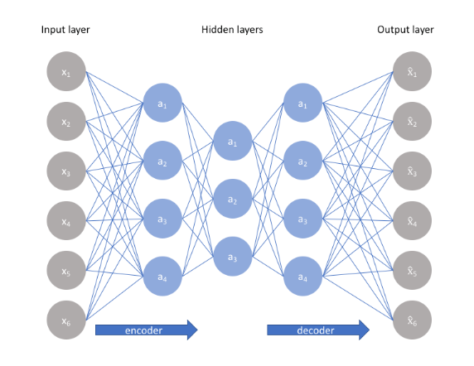

Slide 12
Because neural networks are capable of learning nonlinear relationships, this can be thought of as a more powerful (nonlinear) generalization of PCA. Whereas PCA attempts to discover a lower dimensional hyperplane which describes the original data, autoencoders are capable of learning nonlinear manifolds (a manifold is defined in simple terms as a continuous, non-intersecting surface). The difference between these two approaches is visualized below.

Slide 13
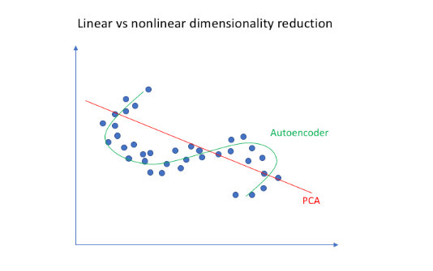

Slide 14
Sparse autoencoders
Sparse autoencoders offer us an alternative method for introducing an information bottleneck without requiring a reduction in the number of nodes at our hidden layers. Rather, we'll construct our loss function such that we penalize activations within a layer. For any given observation, we'll encourage our network to learn an encoding and decoding which only relies on activating a small number of neurons.

Slide 15
A generic sparse autoencoder is visualized below where the opacity of a node corresponds with the level of activation. It's important to note that the individual nodes of a trained model which activate are data-dependent, different inputs will result in activations of different nodes through the network.

Slide 16
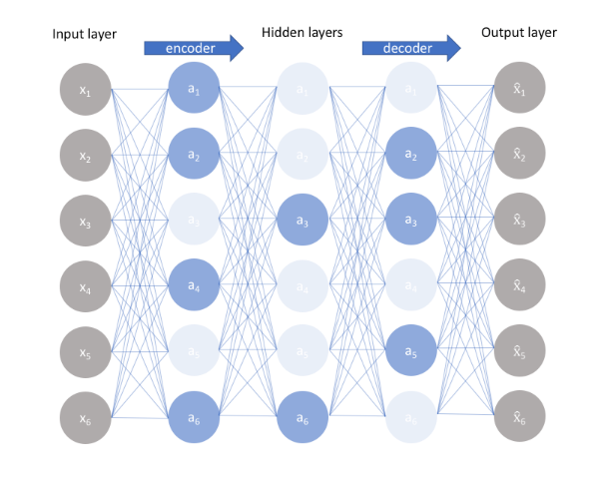

Slide 17
Denoising autoencoders
So far …
1. training a neural network where the input and outputs are identical and our model is tasked with reproducing the input as closely as possible while passing through some sort of information bottleneck.
2. Our autoencoder to be sensitive enough to recreate the original observation but insensitive enough to the training data such that the model learns a generalizable encoding and decoding.

Slide 18
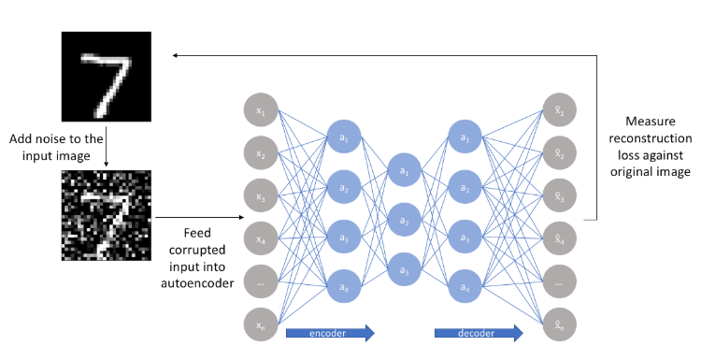
Another approach towards developing a generalizable model is to slightly corrupt the input data but still maintain the uncorrupted data as our target output.

Slide 19
Here, the model learns a vector field for mapping the input data towards a lower-dimensional manifold (i.e. a high-density region where the input data concentrates);
if this manifold accurately describes the natural data, we've effectively "canceled out" the added noise i.e. retains the salient portion of the input

Slide 20
Summary
An autoencoder is a neural network architecture capable of discovering structure within data in order to develop a compressed representation of the input. Many different variants of the general autoencoder architecture exist with the goal of ensuring that the compressed representation represents meaningful attributes of the original data input; typically the biggest challenge when working with autoencoders is getting your model to actually learn a meaningful and generalizable latent space representation.

Slide 21
Variational autoecoders

Slide 22
In contrast to the more standard uses of neural networks as regressors or classifiers, Variational Autoencoders (VAEs) are powerful generative models, now having applications as diverse as from generating fake human faces, to producing purely synthetic music.

Slide 23
When using generative models, you could simply want to generate a random, new output, that looks similar to the training data, and you can certainly do that too with VAEs. But more often, you’d like to alter, or explore variations on data you already have, and not just in a random way either, but in a desired, specific direction. This is where VAEs work better than any other method currently available.

Slide 24
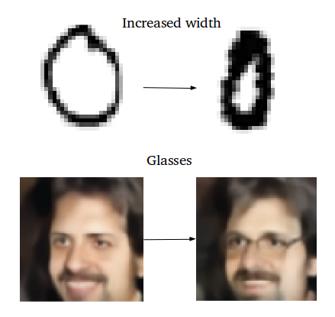

Slide 25
Decoding the standard autoencoder
An autoencoder network is actually a pair of two connected networks, an encoder and a decoder. An encoder network takes in an input, and converts it into a smaller, dense representation, which the decoder network can use to convert it back to the original input.
If you’re unfamiliar with encoder networks, but familiar with Convolutional Neural Networks (CNNs), chances are, you already know what an encoder does.

Slide 26
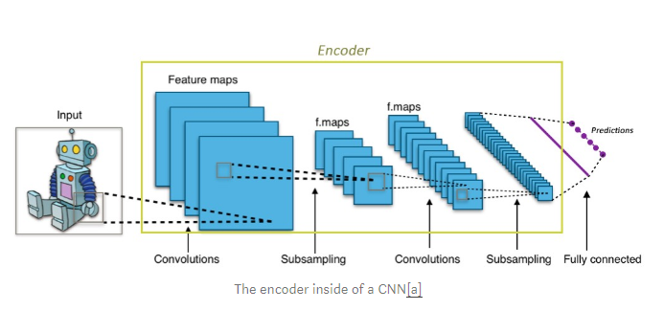

Slide 27
The convolutional layers of any CNN take in a large image (eg. rank 3 tensor of size 299x299x3), and convert it to a much more compact, dense representation (eg. rank 1 tensor of size 1000). This dense representation is then used by the fully connected classifier network to classify the image.
The encoder is similar, it is simply is a network that takes in an input and produces a much smaller representation (the encoding), that contains enough information for the next part of the network to process it into the desired output format.

Slide 28
Typically, the encoder is trained together with the other parts of the network, optimized via back-propagation, to produce encodings specifically useful for the task at hand. In CNNs, the 1000-dimensional encodings produced are such that they’re specifically useful for classification.
Autoencoders take this idea, and slightly flip it on its head, by making the encoder generate encodings specifically useful for reconstructing its own input.

Slide 29
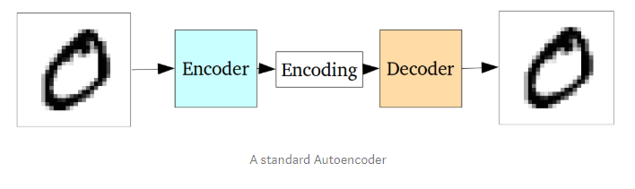
The entire network is usually trained as a whole. The loss function is usually either the mean-squared error or cross-entropy between the output and the input, known as the reconstruction loss, which penalizes the network for creating outputs different from the input.

Slide 30
As the encoding (which is simply the output of the hidden layer in the middle) has far less units than the input, the encoder must choose to discard information. The encoder learns to preserve as much of the relevant information as possible in the limited encoding, and intelligently discard irrelevant parts. The decoder learns to take the encoding and properly reconstruct it into a full image. Together, they form an autoencoder.

Slide 31
The problem with standard autoencoders
Standard autoencoders learn to generate compact representations and reconstruct their inputs well, but asides from a few applications like denoising autoencoders, they are fairly limited.
The fundamental problem with autoencoders, for generation, is that the latent space they convert their inputs to and where their encoded vectors lie, may not be continuous, or allow easy interpolation.

Slide 32
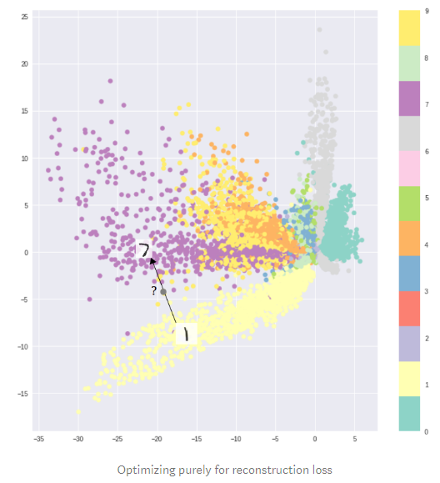

Slide 33
Variational Autoencoders
Variational Autoencoders (VAEs) have one fundamentally unique property that separates them from vanilla autoencoders, and it is this property that makes them so useful for generative modeling: their latent spaces are, by design, continuous, allowing easy random sampling and interpolation.

Slide 34
A variational autoencoder (VAE) provides a probabilistic manner for describing an observation in latent space. Thus, rather than building an encoder which outputs a single value to describe each latent state attribute, we'll formulate our encoder to describe a probability distribution for each latent attribute.

Slide 35
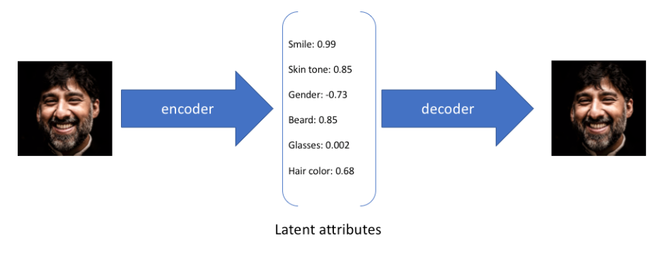
In the example above, we've described the input image in terms of its latent attributes using a single value to describe each attribute. However, we may prefer to represent each latent attribute as a range of possible values. For instance, what single value would you assign for the smile attribute if you feed in a photo of the Mona Lisa? Using a variational autoencoder, we can describe latent attributes in probabilistic terms.

Slide 36
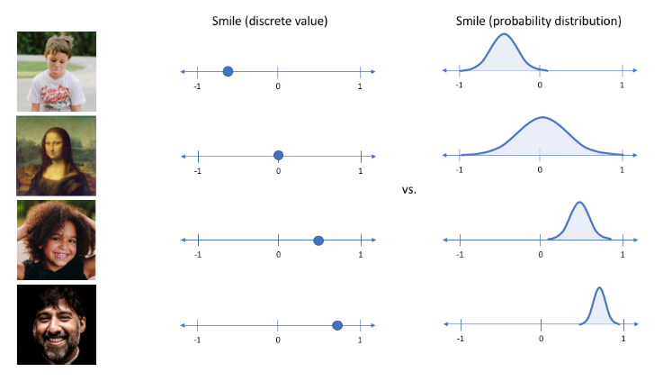

Slide 37
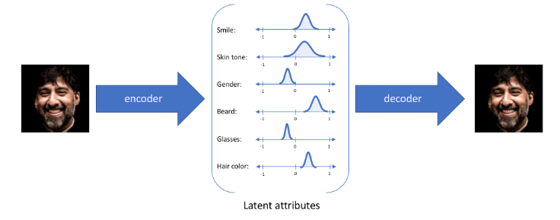
With this approach, we'll now represent each latent attribute for a given input as a probability distribution. When decoding from the latent state, we'll randomly sample from each latent state distribution to generate a vector as input for our decoder model.

Slide 38
Note: For variational autoencoders, the encoder model is sometimes referred to as the recognition model whereas the decoder model is sometimes referred to as the generative model.
By constructing our encoder model to output a range of possible values (a statistical distribution) from which we'll randomly sample to feed into our decoder model, we're essentially enforcing a continuous, smooth latent space representation. For any sampling of the latent distributions, we're expecting our decoder model to be able to accurately reconstruct the input. Thus, values which are nearby to one another in latent space should correspond with very similar reconstructions.

Slide 39
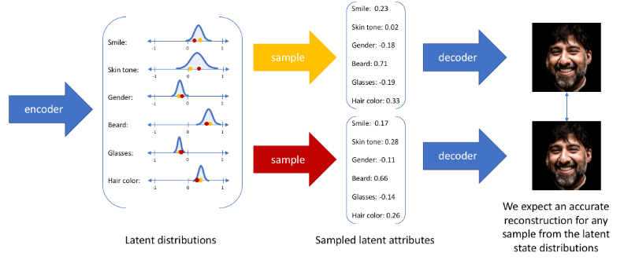

Slide 40
Applications of autoencoders include:
Anomaly detection
Data denoising (ex. images, audio)
Image inpainting
Information retrieval

Slide 41
Sources
https://www.jeremyjordan.me/variational-autoencoders/
https://towardsdatascience.com/intuitively-understanding-variational-autoencoders-1bfe67eb5daf

Slide 42
Videos
https://www.youtube.com/watch?v=Rdpbnd0pCiI
https://www.youtube.com/watch?v=b9COD6To5LM
Sources: Introduction to autoencoders – by Jeremy Jordan

Slide 43
